Slide 1
Data and Computer Communications
Chapter 15 – Local Area Network Overview
Ninth Edition
by William Stallings
Notes:
“Data and Computer Communications”, 9/e, by William Stallings, Chapter 15 “Local Area Network Overview”.

Slide 2
Local Area Network Overview
The whole of this operation is described in minute detail in the official British Naval History, and should be studied with its excellent charts by those who are interested in its technical aspect. So complicated is the full story that the lay reader cannot see the wood for the trees. I have endeavored to render intelligible the broad effects.
—The World Crisis,
Winston Churchill
Notes:
This quote is from the start of Stallings DCC9e Chapter 15.

Slide 3
Local Area Networks (LANs)
usually owned by the organization that is using the network to interconnect equipment
key elements:
topology
transmission medium
wiring layout
medium access control
Notes:
We turn now to a discussion of local area networks (LANs). Whereas wide area networks may be public or private, LANs usually are owned by the organization that is using the network to interconnect equipment. LANs have much greater capacity than wide area networks, to carry what is generally a greater internal communications load.
The key elements of a LAN are
Topology
Transmission medium
Wiring layout
Medium access control
Together, these elements determine not only the cost and capacity of the LAN, but also the type of data that may be transmitted, the speed and efficiency of communications, and even the kinds of applications that can be supported.

Slide 4
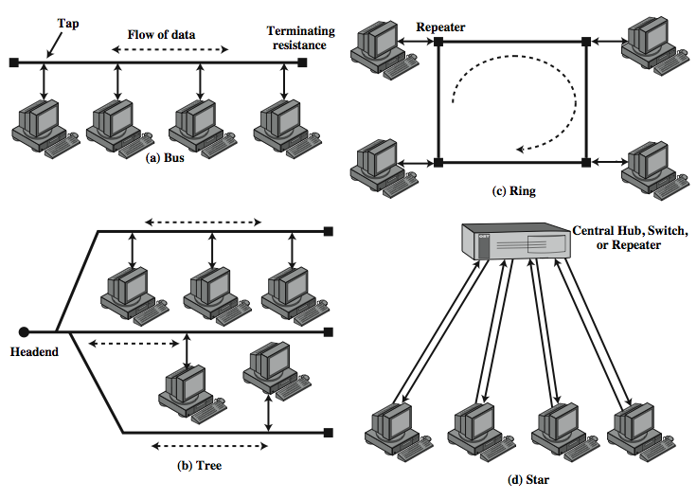
LAN Topologies
Notes:
In the context of a communication network, the term topology refers to the way in which the end points, or stations, attached to the network are interconnected. Historically common topologies for LANs are bus, tree, ring, and star (Stallings DCC9e Figure 15.1). The bus is a special case of the tree, with only one trunk and no branches. In contemporary LANs, the star topology dominates. However, it is useful to look at the operation of the different topologies, especially since the Ethernet LAN, discussed in the next chapter, developed initially as a bus topology.

Slide 5
Bus and Tree
Bus:
stations attach through tap to bus
Tree:
a generalization of bus
full duplex allows transmission and reception
transmission propagates throughout medium
heard by all stations
terminator at each end
branching cable with no closed loops
tree layout begins at headend and branches out
heard by all stations
Notes:
Both bus and tree topologies are characterized by the use of a multipoint medium. For the bus, all stations attach, through appropriate hardware interfacing known as a tap, directly to a linear transmission medium, or bus. Full-duplex operation between the station and the tap allows data to be transmitted onto the bus and received from the bus. A transmission from any station propagates the length of the medium in both directions and can be received by all other stations. At each end of the bus is a terminator, which absorbs any signal, removing it from the bus.
The tree topology is a generalization of the bus topology. The transmission medium is a branching cable with no closed loops. The tree layout begins at a point known as the headend. One or more cables start at the headend, and each of these may have branches. The branches in turn may have additional branches to allow quite complex layouts. Again, a transmission from any station propagates throughout the medium and can be received by all other stations.

Slide 6
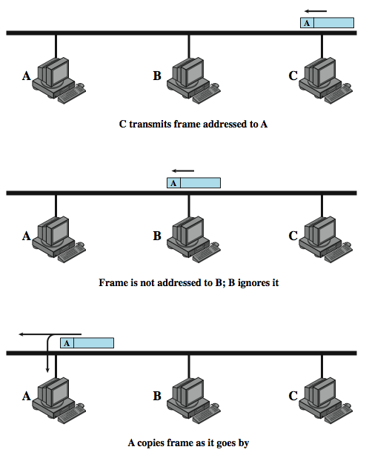
Frame Transmission on Bus LAN
Notes:
Two problems present themselves in this arrangement. First, because a transmission from any one station can be received by all other stations, there needs to be some way of indicating for whom the transmission is intended. Second, a mechanism is needed to regulate transmission. To see the reason for this, consider that if two stations on the bus attempt to transmit at the same time, their signals will overlap and become garbled. Or consider that if one station decides to transmit continuously for a long period of time, other stations will be blocked from transmitting.
To solve these problems, stations transmit data in small blocks, known as frames. Each frame consists of a portion of the data that a station wishes to transmit, plus a frame header that contains control information. Each station on the bus is assigned a unique address, or identifier, and the destination address for a frame is included in its header.
Stallings DCC9e Figure 15.2 illustrates the bus scheme. In this example, station C wishes to transmit a frame of data to A. The frame header includes A's address. As the frame propagates along the bus, it passes B. B observes the address and ignores the frame. A, on the other hand, sees that the frame is addressed to itself and therefore copies the data from the frame as it goes by.
So the frame structure solves the first problem mentioned previously: It provides a mechanism for indicating the intended recipient of data. It also provides the basic tool for solving the second problem, the regulation of access. In particular, the stations take turns sending frames in some cooperative fashion. This involves putting additional control information into the frame header, as discussed later.
With the bus or tree, no special action needs to be taken to remove frames from the medium. When a signal reaches the end of the medium, it is absorbed by the terminator.

Slide 7
Ring Topology
a closed loop of repeaters joined by point-to-point links
receive data on one link & retransmit on another
links unidirectional
stations attach to repeaters
data transmitted in frames
circulate past all stations
destination recognizes address and copies frame
frame circulates back to source where it is removed
medium access control determines when a station can insert frame
Notes:
In the ring topology, the network consists of a set of repeaters joined by point-to-point links in a closed loop. The repeater is a comparatively simple device, capable of receiving data on one link and transmitting them, bit by bit, on the other link as fast as they are received. The links are unidirectional; that is, data are transmitted in one direction only, so that data circulate around the ring in one direction (clockwise or counterclockwise).
Each station attaches to the network at a repeater and can transmit data onto the network through the repeater. As with the bus and tree, data are transmitted in frames. As a frame circulates past all the other stations, the destination station recognizes its address and copies the frame into a local buffer as it goes by. The frame continues to circulate until it returns to the source station, where it is removed. Because multiple stations share the ring, medium access control is needed to determine at what time each station may insert frames.

Slide 8
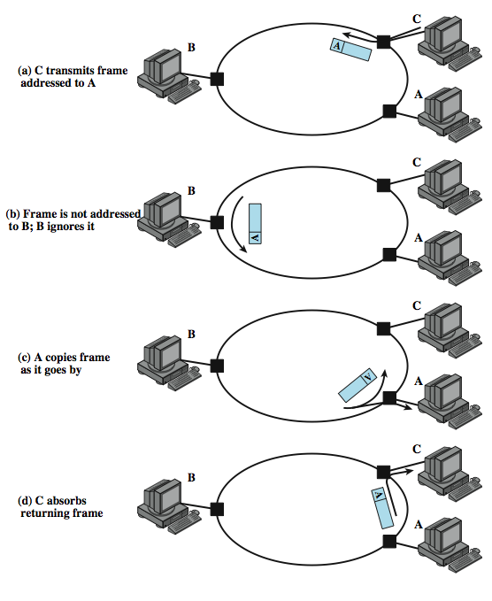
Frame Transmission Ring LAN
Notes:
Stallings DCC9e Figure 15.3 illustrates the ring scheme. In this example, station C wishes to transmit a frame of data to A. The frame header includes A's address. As the frame circulates around the ring, it passes B. B observes the address and ignores the frame. A, on the other hand, sees that the frame is addressed to itself and therefore copies the data from the frame as it goes by.

Slide 9
Star Topology
each station connects to common central node
usually via two point-to-point link
one for transmission and one for reception
central node
operate in broadcast fashion
physical star, logical bus
only one station can transmit at a time (hub)
can act as frame switch
Notes:
In the star LAN topology, each station is directly connected to a common central node. Typically, each station attaches to a central node via two point-to-point links, one for transmission and one for reception.
In general, there are two alternatives for the operation of the central node. One approach is for the central node to operate in a broadcast fashion. A transmission of a frame from one station to the node is retransmitted on all of the outgoing links. In this case, although the arrangement is physically a star, it is logically a bus: A transmission from any station is received by all other stations, and only one station at a time may successfully transmit. In this case, the central element is referred to as a hub. Another approach is for the central node to act as a frame-switching device. An incoming frame is buffered in the node and then retransmitted on an outgoing link to the destination station. These approaches are explored in Section 15.5.

Slide 10
Choice of Topology
factors:
reliability
expandability
performance
medium
wiring layout
access control
Notes:
The choice of topology depends on a variety of factors, including reliability, expandability, and performance. This choice is part of the overall task of designing a LAN and thus cannot be made in isolation, independent of the choice of transmission medium, wiring layout, and access control technique.

Slide 11
Bus LAN Transmission Media
twisted pair
early LANs used voice grade cable
scaling up for higher data rates not practical
baseband coaxial cable
uses digital signaling
original Ethernet
cont…
Notes:
There are four alternative media that can be used for a bus LAN:
Twisted pair: In the early days of LAN development, voice-grade twisted pair was used to provide an inexpensive, easily installed bus LAN. A number of systems operating at 1 Mbps were implemented. Scaling twisted pair up to higher data rates in a shared-medium bus configuration is not practical, so this approach was dropped long ago.
Baseband coaxial cable: A baseband coaxial cable is one that makes use of digital signaling. The original Ethernet scheme makes use of baseband coaxial cable.

Slide 12
Bus LAN Transmission Media
broadband coaxial cable
optical fiber
used in cable TV systems
analog signals at radio and TV frequencies
expensive, hard to install and maintain
expensive taps
better alternatives available
only baseband coaxial cable has achieved widespread use
Notes:
Broadband coaxial cable: Broadband coaxial cable is the type of cable used in cable television systems. Analog signaling is used at radio and television frequencies. This type of system is more expensive and more difficult to install and maintain than baseband coaxial cable. This approach never achieved popularity and such LANs are no longer made.
Optical fiber: There has been considerable research relating to this alternative over the years, but the expense of the optical fiber taps and the availability of better alternatives have resulted in the demise of this option as well.
Thus, for a bus topology, only baseband coaxial cable has achieved widespread use, primarily for Ethernet systems. Compared to a star-topology twisted pair or optical fiber installation, the bus topology using baseband coaxial cable is difficult to work with. Even simple changes may require access to the coaxial cable, movement of taps, and rerouting of cable segments. Accordingly, few if any new installations are being attempted. Despite its limitations, there is a considerable installed base of baseband coaxial cable bus LANs.

Slide 13
Ring and Star Topologies
Ring
very high speed links over long distances
Star
uses natural layout of wiring in building
potential of providing best throughput
single link or repeater failure disables network
best for short distances
high data rates for small number of devices
Notes:
Very-high-speed links over considerable distances can be used for the ring topology. Hence, the ring has the potential of providing the best throughput of any topology. One disadvantage of the ring is that a single link or repeater failure could disable the entire network.
The star topology takes advantage of the natural layout of wiring in a building. It is generally best for short distances and can support a small number of devices at high data rates.

Slide 14
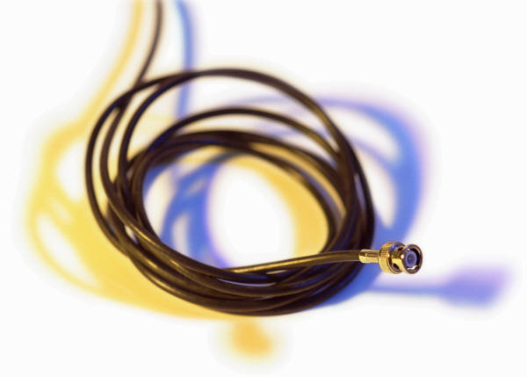
Choice of Medium
constrained by LAN topology
capacity
to support the expected network traffic
reliability
to meet requirements for availability
types of data supported
tailored to the application
environmental scope
provide service over the range of environments
Notes:
The choice of transmission medium is determined by a number of factors. It is, we shall see, constrained by the topology of the LAN. Other factors come into play, including
Capacity: to support the expected network traffic
Reliability: to meet requirements for availability
Types of data supported: tailored to the application
Environmental scope: to provide service over the range of environments required
The choice is part of the overall task of designing a local network, which is addressed in Chapter 16.

Slide 15
Media Available
Voice grade unshielded twisted pair (UTP)
Cat 3 phone, cheap, low data rates
Shielded twisted pair / baseband coaxial
more expensive, higher data rates
Broadband cable
even more expensive, higher data rate
High performance UTP
Cat 5+, very high data rates, suited for star topology
Optical fibre
security, high capacity, small size, high cost
Notes:
Voice-grade unshielded twisted pair (UTP) is an inexpensive, well-understood medium; this is the Category 3 UTP referred to in Chapter 4. Typically, office buildings are wired to meet the anticipated telephone system demand plus a healthy margin; thus, there are no cable installation costs in the use of Category 3 UTP. However, the data rate that can be supported is generally quite limited, with the exception of very small LAN. Category 3 UTP is likely to be the most cost-effective for a single-building, low-traffic LAN installation.
Shielded twisted pair and baseband coaxial cable are more expensive than Category 3 UTP but provide greater capacity. Broadband cable is even more expensive but provides even greater capacity. However, in recent years, the trend has been toward the use of high-performance twisted pair, especially Category 6, Category 6A, and Category 7, as discussed in Chapter 4. These high-performance twisted-pair alternatives are well suited for use with the star topology.
Optical fiber has a number of attractive features, such as electromagnetic isolation, high capacity, and small size, which have attracted a great deal of interest. Market penetration of fiber LANs has increased rapidly in recent years, as the cost of fiber components has dropped and the availability of skilled personnel to install and maintain fiber systems has increased.

Slide 16
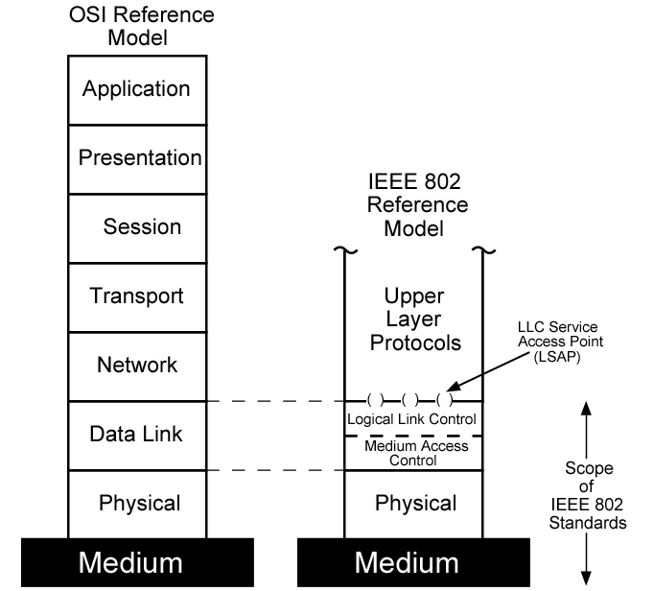
LAN Protocol Architecture
Notes:
The architecture of a LAN is best described in Stallings DCC9e Figure 15.4 in terms of a layering of protocols that organize the basic functions of a LAN. This section opens with a description of the standardized protocol architecture for LANs, which encompasses physical, medium access control (MAC), and logical link control (LLC) layers. The physical layer encompasses topology and transmission medium, and is covered in Section 15.2. This section provides an overview of the MAC and LLC layers.

Slide 17

IEEE 802 Layers
Physical Layer
Encoding / decoding of signals
preamble generation / removal
bit transmission / reception
transmission medium and topology
Notes:
The lowest layer of the IEEE 802 reference model corresponds to the physical layer of the OSI model and includes such functions as
Encoding/decoding of signals
Preamble generation/removal (for synchronization)
Bit transmission/reception
In addition, the physical layer of the 802 model includes a specification of the transmission medium and the topology. Generally, this is considered "below" the lowest layer of the OSI model. However, the choice of transmission medium and topology is critical in LAN design, and so a specification of the medium is included.

Slide 18
IEEE 802 Layers
Logical Link Control Layer (LLC)
provide interface to higher levels
perform flow and error control
Media Access Control
on transmit assemble data into frame
on reception disassemble frame, perform address recognition and error detection
govern access to transmission medium
for same LLC, may have several MAC options
Notes:
Above the physical layer are the functions associated with providing service to LAN users. These include
On transmission, assemble data into a frame with address and error-detection fields.
On reception, disassemble frame, and perform address recognition and error detection.
Govern access to the LAN transmission medium.
Provide an interface to higher layers and perform flow and error control.
These are functions typically associated with OSI layer 2. The set of functions in the last bullet item are grouped into a logical link control (LLC) layer. The functions in the first three bullet items are treated as a separate layer, called medium access control (MAC). The separation is done for the following reasons:
The logic required to manage access to a shared-access medium is not found in traditional layer 2 data link control.
For the same LLC, several MAC options may be provided.

Slide 19
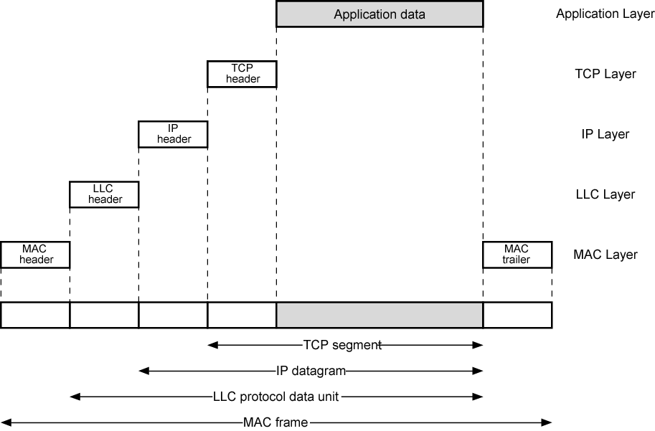
LAN Protocols in Context
Notes:
Stallings DCC9e Figure 15.5 illustrates the relationship between the levels of the architecture (compare Stallings DCC9e Figure 2.5). Higher-level data are passed down to LLC, which appends control information as a header, creating an LLC protocol data unit (PDU). This control information is used in the operation of the LLC protocol. The entire LLC PDU is then passed down to the MAC layer, which appends control information at the front and back of the packet, forming a MAC frame. Again, the control information in the frame is needed for the operation of the MAC protocol. For context, the figure also shows the use of TCP/IP and an application layer above the LAN protocols.

Slide 20
Logical Link Control
transmission of link level PDUs between stations
must support multi-access, shared medium
relieved of some details of link access by the MAC layer
addressing involves specifying source and destination LLC users
referred to as service access points (SAPs)
Notes:
The LLC layer for LANs is similar in many respects to other link layers in common use. Like all link layers, LLC is concerned with the transmission of a link-level PDU between two stations, without the necessity of an intermediate switching node. LLC has two characteristics not shared by most other link control protocols:
1. It must support the multi-access, shared-medium nature of the link (this differs from a multidrop line in that there is no primary node).
2. It is relieved of some details of link access by the MAC layer.
Addressing in LLC involves specifying the source and destination LLC users. Typically, a user is a higher-layer protocol or a network management function in the station. These LLC user addresses are referred to as service access points (SAPs), in keeping with OSI terminology for the user of a protocol layer.
We look first at the services that LLC provides to a higher-level user, and then at the LLC protocol.

Slide 21
LLC Services
unacknowledged connectionless service
data-gram style service
connection-mode service
logical connection is set up between two users
delivery of data is not guaranteed
flow and error control are provided
acknowledged connectionless service
datagrams are to be acknowledged, but no logical connection is set up
Notes:
LLC specifies the mechanisms for addressing stations across the medium and for controlling the exchange of data between two users. The operation and format of this standard is based on HDLC. Three services are provided as alternatives for attached devices using LLC:
Unacknowledged connectionless service: This service is a datagram-style service. It is a very simple service that does not involve any of the flow- and error-control mechanisms. Thus, the delivery of data is not guaranteed. However, in most devices, there will be some higher layer of software that deals with reliability issues.
Connection-mode service: This service is similar to that offered by HDLC. A logical connection is set up between two users exchanging data, and flow control and error control are provided.
Acknowledged connectionless service: This is a cross between the previous two services. It provides that datagrams are to be acknowledged, but no prior logical connection is set up.
Typically, a vendor will provide these services as options that the customer can select when purchasing the equipment. Alternatively, the customer can purchase equipment that provides two or all three services and select a specific service based on application.

Slide 22
LLC Service Alternatives
unacknowledged connectionless service
requires minimum logic
connection-mode service
used in simple devices
avoids duplication of mechanisms
preferred option in most cases
provides flow control and reliability mechanisms
acknowledged connectionless service
large communication channel needed
time critical or emergency control signals
Notes:
The unacknowledged connectionless service requires minimum logic and is useful in two contexts. First, it will often be the case that higher layers of software will provide the necessary reliability and flow-control mechanism, and it is efficient to avoid duplicating them. For example, TCP could provide the mechanisms needed to ensure that data is delivered reliably. Second, there are instances in which the overhead of connection establishment and maintenance is unjustified or even counterproductive (for example, data collection activities that involve the periodic sampling of data sources, such as sensors and automatic self-test reports from security equipment or network components). In a monitoring application, the loss of an occasional data unit would not cause distress, as the next report should arrive shortly. Thus, in most cases, the unacknowledged connectionless service is the preferred option.
The connection-mode service could be used in very simple devices, such as terminal controllers, that have little software operating above this level. In these cases, it would provide the flow control and reliability mechanisms normally implemented at higher layers of the communications software.
The acknowledged connectionless service is useful in several contexts. With the connection-mode service, the logical link control software must maintain some sort of table for each active connection, to keep track of the status of that connection. If the user needs guaranteed delivery but there are a large number of destinations for data, then the connection-mode service may be impractical because of the large number of tables required. An example is a process control or automated factory environment where a central site may need to communicate with a large number of processors and programmable controllers. Another use of this is the handling of important and time-critical alarm or emergency control signals in a factory. Because of their importance, an acknowledgment is needed so that the sender can be assured that the signal got through. Because of the urgency of the signal, the user might not want to take the time first to establish a logical connection and then send the data.

Slide 23
LLC Protocol
modeled after HDLC
asynchronous balanced mode
connection mode (type 2) LLC service
unacknowledged connectionless service
using unnumbered information PDUs (type 1)
acknowledged connectionless service
using 2 new unnumbered PDUs (type 3)
permits multiplexing using LSAPs
Notes:
The basic LLC protocol is modeled after HDLC and has similar functions and formats. The differences between the two protocols can be summarized as follows:
LLC makes use of the asynchronous balanced mode of operation of HDLC, to support connection-mode LLC service; this is referred to as type 2 operation. The other HDLC modes are not employed.
LLC supports an unacknowledged connectionless service using the unnumbered information PDU; this is known as type 1 operation.
LLC supports an acknowledged connectionless service by using two new unnumbered PDUs; this is known as type 3 operation.
LLC permits multiplexing by the use of LLC service access points (LSAPs).

Slide 24
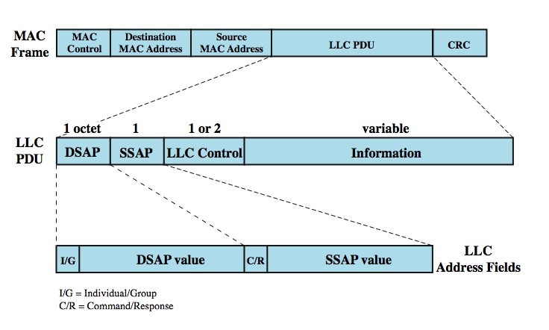
MAC Frame Format
Notes:
All three LLC protocols employ the same PDU format (Stallings Dcc9e Figure 15.6), which consists of four fields. The DSAP (Destination Service Access Point) and SSAP (Source Service Access Point) fields each contain a 7-bit address, which specify the destination and source users of LLC. One bit of the DSAP indicates whether the DSAP is an individual or group address. One bit of the SSAP indicates whether the PDU is a command or response PDU. The format of the LLC control field is identical to that of HDLC (Figure 7.7), using extended (7-bit) sequence numbers.
For type 1 operation, which supports the unacknowledged connectionless service, the unnumbered information (UI) PDU is used to transfer user data. There is no acknowledgment, flow control, or error control. However, there is error detection and discard at the MAC level.
Two other PDUs are used to support management functions associated with all three types of operation. Both PDUs are used in the following fashion. An LLC entity may issue a command (C/R bit = 0) XID or TEST. The receiving LLC entity issues a corresponding XID or TEST in response. The XID PDU is used to exchange two types of information: types of operation supported and window size. The TEST PDU is used to conduct a loopback test of the transmission path between two LLC entities. Upon receipt of a TEST command PDU, the addressed LLC entity issues a TEST response PDU as soon as possible.
With type 2 operation, a data link connection is established between two LLC SAPs prior to data exchange. Connection establishment is attempted by the type 2 protocol in response to a request from a user. The LLC entity issues a SABME PDU to request a logical connection with the other LLC entity. If the connection is accepted by the LLC user designated by the DSAP, then the destination LLC entity returns an unnumbered acknowledgment (UA) PDU. The connection is henceforth uniquely identified by the pair of user SAPs. If the destination LLC user rejects the connection request, its LLC entity returns a disconnected mode (DM) PDU.
Once the connection is established, data are exchanged using information PDUs, as in HDLC. The information PDUs include send and receive sequence numbers, for sequencing and flow control. The supervisory PDUs are used, as in HDLC, for flow control and error control. Either LLC entity can terminate a logical LLC connection by issuing a disconnect (DISC) PDU.
With type 3 operation, each transmitted PDU is acknowledged. A new (not found in HDLC) unnumbered PDU, the Acknowledged Connectionless (AC) Information PDU, is defined. User data are sent in AC command PDUs and must be acknowledged using an AC response PDU. To guard against lost PDUs, a 1-bit sequence number is used. The sender alternates the use of 0 and 1 in its AC command PDU, and the receiver responds with an AC PDU with the opposite number of the corresponding command. Only one PDU in each direction may be outstanding at any time.

Slide 25
Medium Access Control (MAC) Protocol
controls access to the transmission medium
key parameters:
where
greater control, single point of failure
more complex, but more redundant
how
synchronous
capacity dedicated to connection, not optimal
asynchronous
response to demand
round robin, reservation, contention
Notes:
All LANs and MANs consist of collections of devices that must share the network's transmission capacity. Some means of controlling access to the transmission medium is needed to provide for an orderly and efficient use of that capacity. This is the function of a medium access control (MAC) protocol.
The key parameters in any medium access control technique are where and how. Where refers to whether control is exercised in a centralized or distributed fashion. In a centralized scheme, a controller is designated that has the authority to grant access to the network. A station wishing to transmit must wait until it receives permission from the controller. In a decentralized network, the stations collectively perform a medium access control function to determine dynamically the order in which stations transmit. A centralized scheme has certain advantages, including
It may afford greater control over access for providing such things as priorities, overrides, and guaranteed capacity.
It enables the use of relatively simple access logic at each station.
It avoids problems of distributed coordination among peer entities
The principal disadvantages of centralized schemes are
It creates a single point of failure; that is, there is a point in the network that, if it fails, causes the entire network to fail.
It may act as a bottleneck, reducing performance.
The pros and cons of distributed schemes are mirror images of the points just made.
The second parameter, how, is constrained by the topology and is a tradeoff among competing factors, including cost, performance, and complexity. In general, we can categorize access control techniques as being either synchronous or asynchronous. With synchronous techniques, a specific capacity is dedicated to a connection. This is the same approach used in circuit switching, frequency division multiplexing (FDM), and synchronous time division multiplexing (TDM). Such techniques are generally not optimal in LANs and MANs because the needs of the stations are unpredictable. It is preferable to be able to allocate capacity in an asynchronous (dynamic) fashion, more or less in response to immediate demand. The asynchronous approach can be further subdivided into three categories: round robin, reservation, and contention.

Slide 26
Asynchronous Systems
round robin
each station given turn to transmit data
reservation
divide medium into slots
contention
all stations contend for time
good for stream traffic
good for bursty traffic
simple to implement
tends to collapse under heavy load
Notes:
ROUND ROBIN
With round robin, each station in turn is given the opportunity to transmit. During that opportunity, the station may decline to transmit or may transmit subject to a specified upper bound, usually expressed as a maximum amount of data transmitted or time for this opportunity. In any case, the station, when it is finished, relinquishes its turn, and the right to transmit passes to the next station in logical sequence. Control of sequence may be centralized or distributed. Polling is an example of a centralized technique.
When many stations have data to transmit over an extended period of time, round-robin techniques can be very efficient. If only a few stations have data to transmit over an extended period of time, then there is a considerable overhead in passing the turn from station to station, because most of the stations will not transmit but simply pass their turns. Under such circumstances other techniques may be preferable, largely depending on whether the data traffic has a stream or bursty characteristic. Stream traffic is characterized by lengthy and fairly continuous transmissions; examples are voice communication, telemetry, and bulk file transfer. Bursty traffic is characterized by short, sporadic transmissions; interactive terminal-host traffic fits this description.
RESERVATION
For stream traffic, reservation techniques are well suited. In general, for these techniques, time on the medium is divided into slots, much as with synchronous TDM. A station wishing to transmit reserves future slots for an extended or even an indefinite period. Again, reservations may be made in a centralized or distributed fashion.
CONTENTION
For bursty traffic, contention techniques are usually appropriate. With these techniques, no control is exercised to determine whose turn it is; all stations contend for time in a way that can be, as we shall see, rather rough and tumble. These techniques are of necessity distributed in nature. Their principal advantage is that they are simple to implement and, under light to moderate load, efficient. For some of these techniques, however, performance tends to collapse under heavy load.
Although both centralized and distributed reservation techniques have been implemented in some LAN products, round-robin and contention techniques are the most common.

Slide 27
MAC Frame Handling
MAC layer receives data from LLC layer
PDU is referred to as a MAC frame
fields:
MAC control
destination MAC address
source MAC address
LLC
CRC
MAC layer detects errors and discards frames
LLC optionally retransmits unsuccessful frames
Notes:
The MAC layer receives a block of data from the LLC layer and is responsible for performing functions related to medium access and for transmitting the data. As with other protocol layers, MAC implements these functions making use of a protocol data unit at its layer. In this case, the PDU is referred to as a MAC frame.
The exact format of the MAC frame differs somewhat for the various MAC protocols in use. In general, all of the MAC frames have a format similar to that of Stallings DCC9e Figure 15.6. The fields of this frame are
MAC Control: This field contains any protocol control information needed for the functioning of the MAC protocol. For example, a priority level could be indicated here.
Destination MAC Address: The destination physical attachment point on the LAN for this frame.
Source MAC Address: The source physical attachment point on the LAN for this frame.
LLC: The LLC data from the next higher layer.
CRC: The Cyclic Redundancy Check field (also known as the frame check sequence, FCS, field). This is an error-detecting code, as we have seen in HDLC and other data link control protocols (Chapter 7).
In most data link control protocols, the data link protocol entity is responsible not only for detecting errors using the CRC, but for recovering from those errors by retransmitting damaged frames. In the LAN protocol architecture, these two functions are split between the MAC and LLC layers. The MAC layer is responsible for detecting errors and discarding any frames that are in error. The LLC layer optionally keeps track of which frames have been successfully received and retransmits unsuccessful frames.

Slide 28
Bridges
connects similar LANs with identical physical and link layer protocols
minimal processing
can map between MAC formats
reasons for use:
reliability
performance
security
geography
Notes:
In virtually all cases, there is a need to expand beyond the confines of a single LAN, to provide interconnection to other LANs and to wide area networks. Two general approaches are used for this purpose: bridges and routers. The bridge is the simpler of the two devices and provides a means of interconnecting similar LANs. The router is a more general-purpose device, capable of interconnecting a variety of LANs and WANs. We explore bridges in this section and look at routers in Part Five.
The bridge is designed for use between local area networks (LANs) that use identical protocols for the physical and link layers (e.g., all conforming to IEEE 802.3). Because the devices all use the same protocols, the amount of processing required at the bridge is minimal. More sophisticated bridges are capable of mapping from one MAC format to another (e.g., to interconnect an Ethernet and a token ring LAN).
Because the bridge is used in a situation in which all the LANs have the same characteristics, the reader may ask, why not simply have one large LAN? Depending on circumstance, there are several reasons for the use of multiple LANs connected by bridges:
Reliability: The danger in connecting all data processing devices in an organization to one network is that a fault on the network may disable communication for all devices. By using bridges, the network can be partitioned into self-contained units.
Performance: In general, performance on a LAN declines with an increase in the number of devices or the length of the wire. A number of smaller LANs will often give improved performance if devices can be clustered so that intranetwork traffic significantly exceeds internetwork traffic.
Security: The establishment of multiple LANs may improve security of communications. It is desirable to keep different types of traffic (e.g., accounting, personnel, strategic planning) that have different security needs on physically separate media. At the same time, the different types of users with different levels of security need to communicate through controlled and monitored mechanisms.
Geography: Clearly, two separate LANs are needed to support devices clustered in two geographically distant locations. Even in the case of two buildings separated by a highway, it may be far easier to use a microwave bridge link than to attempt to string coaxial cable between the two buildings.

Slide 29
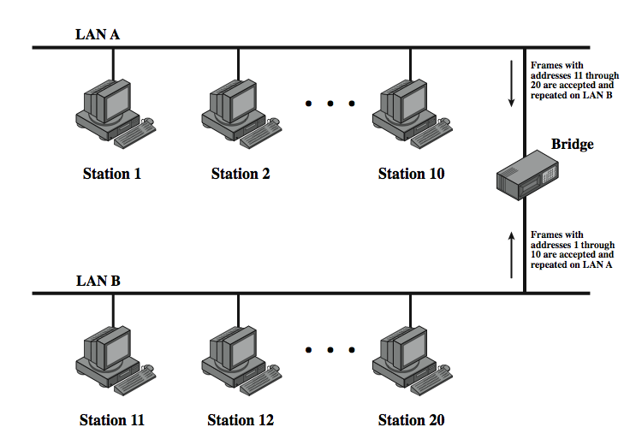
Bridge Function
Notes:
Stallings Dcc9e Figure 15.7 illustrates the action of a bridge connecting two LANs, A and B, using the same MAC protocol. In this example, a single bridge attaches to both LANs; frequently, the bridge function is performed by two "half-bridges," one on each LAN. The functions of the bridge are few and simple:
•Read all frames transmitted on A and accept those addressed to any station on B.
•Using the medium access control protocol for B, retransmit each frame on B.
•Do the same for B-to-A traffic.

Slide 30
Bridge Design Aspects
no modification to frame content or format
no encapsulation
exact bitwise copy of frame
buffering to meet peak demand
contains routing and address intelligence
may connect more than two LANs
bridging is transparent to stations
Notes:
Several design aspects of a bridge are worth highlighting:
The bridge makes no modification to the content or format of the frames it receives, nor does it encapsulate them with an additional header. Each frame to be transferred is simply copied from one LAN and repeated with exactly the same bit pattern on the other LAN. Because the two LANs use the same LAN protocols, it is permissible to do this.
The bridge should contain enough buffer space to meet peak demands. Over a short period of time, frames may arrive faster than they can be retransmitted.
The bridge must contain addressing and routing intelligence. At a minimum, the bridge must know which addresses are on each network to know which frames to pass. Further, there may be more than two LANs interconnected by a number of bridges. In that case, a frame may have to be routed through several bridges in its journey from source to destination.
A bridge may connect more than two LANs.
In summary, the bridge provides an extension to the LAN that requires no modification to the communications software in the stations attached to the LANs. It appears to all stations on the two (or more) LANs that there is a single LAN on which each station has a unique address. The station uses that unique address and need not explicitly discriminate between stations on the same LAN and stations on other LANs; the bridge takes care of that.

Slide 31
Bridge Protocol Architecture
IEEE 802.1D defines architecture
MAC level designates endpoint
bridge does not need LLC layer
captures frame
encapsulates it
forwards it across link
removes encapsulation
transmits to destination
Notes:
The IEEE 802.1D specification defines the protocol architecture for MAC bridges. Within the 802 architecture, the endpoint or station address is designated at the MAC level. Thus, it is at the MAC level that a bridge can function. Stallings DCC9e Figure 15.8 shows the simplest case, which consists of two LANs connected by a single bridge. The LANs employ the same MAC and LLC protocols. The bridge operates as previously described. A MAC frame whose destination is not on the immediate LAN is captured by the bridge, buffered briefly, and then transmitted on the other LAN. As far as the LLC layer is concerned, there is a dialogue between peer LLC entities in the two endpoint stations. The bridge need not contain an LLC layer because it is merely serving to relay the MAC frames.
The concept of a MAC relay bridge is not limited to the use of a single bridge to connect two nearby LANs. If the LANs are some distance apart, then they can be connected by two bridges that are in turn connected by a communications facility. The intervening communications facility can be a network, such as a wide area packet-switching network, or a point-to-point link. In such cases, when a bridge captures a MAC frame, it must encapsulate the frame in the appropriate packaging and transmit it over the communications facility to a target bridge. The target bridge strips off these extra fields and transmits the original, unmodified MAC frame to the destination station.

Slide 32
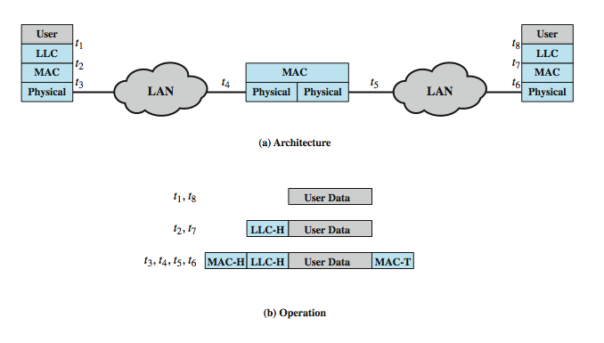
Connection of Two LANs
Notes:
Stallings DCC9e Figure 15.8b indicates the way in which data are encapsulated using a bridge. Data are provided by some user to LLC. The LLC entity appends a header and passes the resulting data unit to the MAC entity, which appends a header and a trailer to form a MAC frame. On the basis of the destination MAC address in the frame, it is captured by the bridge. The bridge does not strip off the MAC fields; its function is to relay the MAC frame intact to the destination LAN. Thus, the frame is deposited on the destination LAN and captured by the destination station.

Slide 33
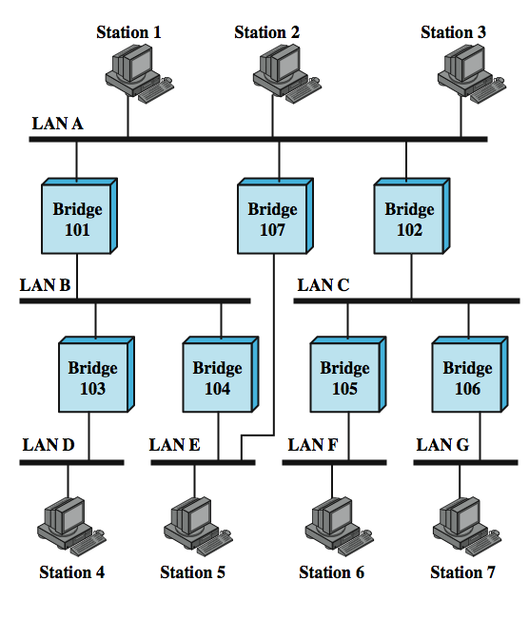
Bridges and LANs with Alternative Routes
Notes:
There is a trend within many organizations to an increasing number of LANs interconnected by bridges. As the number of LANs grows, it becomes important to provide alternate paths between LANs via bridges for load balancing and reconfiguration in response to failure. Thus, many organizations will find that static, preconfigured routing tables are inadequate and that some sort of dynamic routing is needed.
Consider the configuration of Stallings DCC9e Figure 15.9. Suppose that station 1 transmits a frame on LAN A intended for station 6. The frame will be read by bridges 101, 102, and 107. For each bridge, the addressed station is not on a LAN to which the bridge is attached. Therefore, each bridge must make a decision whether or not to retransmit the frame on its other LAN, in order to move it closer to its intended destination. In this case, bridge 102 should repeat the frame on LAN C, whereas bridges 101 and 107 should refrain from retransmitting the frame. Once the frame has been transmitted on LAN C, it will be picked up by both bridges 105 and 106. Again, each must decide whether or not to forward the frame. In this case, bridge 105 should retransmit the frame on LAN F, where it will be received by the destination, station 6.
Thus we see that, in the general case, the bridge must be equipped with a routing capability. When a bridge receives a frame, it must decide whether or not to forward it. If the bridge is attached to two or more networks, then it must decide whether or not to forward the frame and, if so, on which LAN the frame should be transmitted.
The routing decision may not always be a simple one. Figure 15.9 also shows that there are two routes between LAN A and LAN E. Such redundancy provides for higher overall Internet availability and creates the possibility for load balancing. In this case, if station 1 transmits a frame on LAN A intended for station 5 on LAN E, then either bridge 101 or bridge 107 could forward the frame. It would appear preferable for bridge 107 to forward the frame, since it will involve only one hop, whereas if the frame travels through bridge 101, it must suffer two hops. Another consideration is that there may be changes in the configuration. For example, bridge 107 may fail, in which case subsequent frames from station 1 to station 5 should go through bridge 101. So we can say that the routing capability must take into account the topology of the internet configuration and may need to be dynamically altered.

Slide 34
Fixed Routing
simplest and most common
suitable for Internets that are stable
a fixed route is selected for each pair of LANs
usually least hop route
only changed when topology changes
widely used but limited flexibility
Notes:
A variety of routing strategies have been proposed and implemented in recent years. The simplest and most common strategy is fixed routing. This strategy is suitable for small internets and for internets that are relatively stable. In addition, two groups within the IEEE 802 committee have developed specifications for routing strategies. The IEEE 802.1 group has issued a standard for routing based on the use of a spanning tree algorithm. The token ring committee, IEEE 802.5, has issued its own specification, referred to as source routing. In the remainder of this section, we look at fixed routing and the spanning tree algorithm, which is the most commonly used bridge routing algorithm.
For fixed routing, a route is selected for each source-destination pair of LANs in the configuration. If alternate routes are available between two LANs, then typically the route with the least number of hops is selected. The routes are fixed, or at least only change when there is a change in the topology of the internet.
The strategy for developing a fixed routing configuration for bridges is similar to that employed in a packet-switching network (Stallings DCC9e Figure 12.2). A central routing matrix is created, to be stored perhaps at a network control center. The matrix shows, for each source-destination pair of LANs, the identity of the first bridge on the route.
Once the directories have been established, routing is a simple matter. A bridge copies each incoming frame on each of its LANs. If the destination MAC address corresponds to an entry in its routing table, the frame is retransmitted on the appropriate LAN.
The fixed routing strategy is widely used in commercially available products. It requires that a network manager manually load the data into the routing tables. It has the advantage of simplicity and minimal processing requirements. However, in a complex internet, in which bridges may be dynamically added and in which failures must be allowed for, this strategy is too limited.

Slide 35
Spanning Tree
bridge automatically develops routing table
automatically updates routing table in response to changing topology
algorithm consists of three mechanisms:
frame forwarding
address learning
loop resolution
Notes:
The spanning tree approach is a mechanism in which bridges automatically develop a routing table and update that table in response to changing topology. The algorithm consists of three mechanisms: frame forwarding, address learning, and loop resolution.

Slide 36
Frame Forwarding
maintain forwarding database for each port
for a frame arriving on port X:
search forwarding database to see if MAC address is listed for any port except X
if address not found, forward to all ports except X
if address listed for port Y, check port Y for blocking or forwarding state
if not blocked, transmit frame through port Y
Notes:
In this scheme, a bridge maintains a forwarding database for each port attached to a LAN. The database indicates the station addresses for which frames should be forwarded through that port. We can interpret this in the following fashion. For each port, a list of stations is maintained. A station is on the list if it is on the "same side" of the bridge as the port. For example, for bridge 102 of Stallings DCC9e Figure 15.9, stations on LANs C, F, and G are on the same side of the bridge as the LAN C port, and stations on LANs A, B, D, and E are on the same side of the bridge as the LAN A port. When a frame is received on any port, the bridge must decide whether that frame is to be forwarded through the bridge and out through one of the bridge's other ports. Suppose that a bridge receives a MAC frame on port x. The following rules are applied:
1. Search the forwarding database to determine if the MAC address is listed for any port except port x.
2. If the destination MAC address is not found, forward frame out all ports except the one from which is was received. This is part of the learning process described subsequently.
3. If the destination address is in the forwarding database for some port y, then determine whether port y is in a blocking or forwarding state. For reasons explained later, a port may sometimes be blocked, which prevents it from receiving or transmitting frames.
4. If port y is not blocked, transmit the frame through port y onto the LAN to which that port attaches.

Slide 37
Address Learning
can preload forwarding database
when frame arrives at port X, it has come from the LAN attached to port X
use source address to update forwarding database for port X to include that address
have a timer on each entry in database
if timer expires, entry is removed
each time frame arrives, source address checked against forwarding database
if present timer is reset and direction recorded
if not present entry is created and timer set
Notes:
The preceding scheme assumes that the bridge is already equipped with a forwarding database that indicates the direction, from the bridge, of each destination station. This information can be preloaded into the bridge, as in fixed routing. However, an effective automatic mechanism for learning the direction of each station is desirable. A simple scheme for acquiring this information is based on the use of the source address field in each MAC frame.
The strategy is this. When a frame arrives on a particular port, it clearly has come from the direction of the incoming LAN. The source address field of the frame indicates the source station. Thus, a bridge can update its forwarding database for that port on the basis of the source address field of each incoming frame. To allow for changes in topology, each element in the database is equipped with a timer. When a new element is added to the database, its timer is set. If the timer expires, then the element is eliminated from the database, since the corresponding direction information may no longer be valid. Each time a frame is received, its source address is checked against the database. If the element is already in the database, the entry is updated (the direction may have changed) and the timer is reset. If the element is not in the database, a new entry is created, with its own timer.

Slide 38
Spanning Tree Algorithm
address learning works for tree layout if there are no alternate routes in the network
alternate route means there is a closed loop
for any connected graph there is a spanning tree maintaining connectivity with no closed loops
algorithm must be dynamic
IEEE 802.1 Spanning Tree Algorithm:
each bridge assigned unique identifier
cost assigned to each bridge port
exchange information between bridges to find spanning tree
automatically updated whenever topology changes
Notes:
The address learning mechanism described previously is effective if the topology of the internet is a tree; that is, if there are no alternate routes in the network. The existence of alternate routes means that there is a closed loop. For example in Stallings DCC9e Figure 15.9, the following is a closed loop: LAN A, bridge 101, LAN B, bridge 104, LAN E, bridge 107, LAN A.
To overcome this problem, a simple result from graph theory is used: For any connected graph, consisting of nodes and edges connecting pairs of nodes, there is a spanning tree of edges that maintains the connectivity of the graph but contains no closed loops. In terms of internets, each LAN corresponds to a graph node, and each bridge corresponds to a graph edge. Thus, in Figure 15.9, the removal of one (and only one) of bridges 107, 101, and 104, results in a spanning tree. What is desired is to develop a simple algorithm by which the bridges of the internet can exchange sufficient information to automatically (without user intervention) derive a spanning tree. The algorithm must be dynamic. That is, when a topology change occurs, the bridges must be able to discover this fact and automatically derive a new spanning tree.
The spanning tree algorithm developed by IEEE 802.1, as the name suggests, is able to develop such a spanning tree. All that is required is that each bridge be assigned a unique identifier and that costs be assigned to each bridge port. In the absence of any special considerations, all costs could be set equal; this produces a minimum-hop tree. The algorithm involves a brief exchange of messages among all of the bridges to discover the minimum-cost spanning tree. Whenever there is a change in topology, the bridges automatically recalculate the spanning tree.

Slide 39
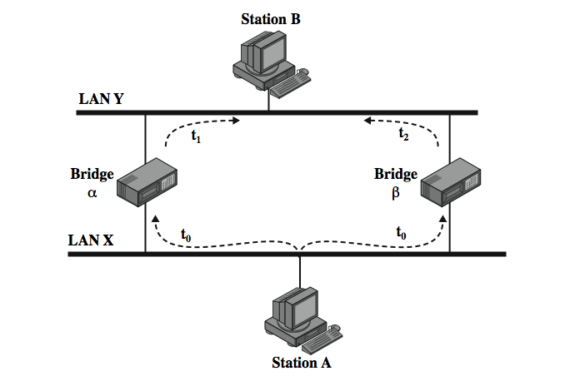
Loop of Bridges
Notes:
To see the problem created by a closed loop, consider Stallings DCC9e Figure 15.10. At time t0, station A transmits a frame addressed to station B. The frame is captured by both bridges. Each bridge updates its database to indicate that station A is in the direction of LAN X, and retransmits the frame on LAN Y. Say that bridge a retransmits at time t1 and bridge b a short time later t2. Thus B will receive two copies of the frame. Furthermore, each bridge will receive the other's transmission on LAN Y. Note that each transmission is a frame with a source address of A and a destination address of B. Thus each bridge will update its database to indicate that station A is in the direction of LAN Y. Neither bridge is now capable of forwarding a frame addressed to station A.

Slide 40
Interconnecting LANs - Hubs
active central element of star layout
each station connected to hub by two UTP lines
hub acts as a repeater
limited to about 100m by UTP properties
optical fiber may be used out to 500m
physically star, logically bus
transmission from a station seen by all others
if two stations transmit at the same time have a collision
Notes:
In recent years, there has been a proliferation of types of devices for interconnecting LANs that goes beyond the bridges discussed in Stallings DCC9e Section 15.4 and the routers discussed in Part Five. These devices can conveniently be grouped into the categories of hubs and switches.
Hubs
Earlier, we used the term hub in reference to a star-topology LAN. The hub is the active central element of the star layout. Each station is connected to the hub by two lines (transmit and receive). The hub acts as a repeater: When a single station transmits, the hub repeats the signal on the outgoing line to each station. Ordinarily, the line consists of two unshielded twisted pairs. Because of the high data rate and the poor transmission qualities of unshielded twisted pair, the length of a line is limited to about 100 m. As an alternative, an optical fiber link may be used. In this case, the maximum length is about 500 m.
Note that although this scheme is physically a star, it is logically a bus: A transmission from any one station is received by all other stations, and if two stations transmit at the same time there will be a collision.

Slide 41
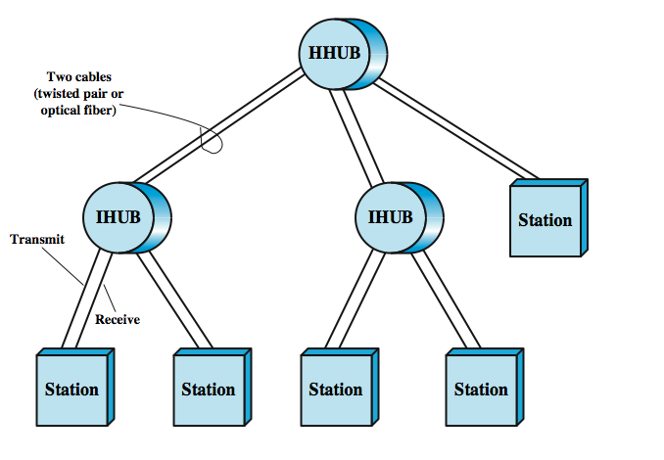
Two Level Hub Topology
Notes:
Multiple levels of hubs can be cascaded in a hierarchical configuration. Stallings DCC9e Figure 15.11 illustrates a two-level configuration. There is one header hub (HHUB) and one or more intermediate hubs (IHUB). Each hub may have a mixture of stations and other hubs attached to it from below. This layout fits well with building wiring practices. Typically, there is a wiring closet on each floor of an office building, and a hub can be placed in each one. Each hub could service the stations on its floor.

Slide 42
Buses, Hubs and Switches
bus configuration
all stations share capacity of bus (e.g. 10Mbps)
hub uses star wiring to attach stations
transmission from any station received by hub and retransmitted on all outgoing lines
only one station transmitting at a time
only one station can transmit at a time
total capacity of LAN is 10 Mbps
can improve performance using a layer 2 switch
can switch multiple frames between separate ports
multiplying capacity of LAN
Notes:
A hub, often in a building wiring closet, uses a star wiring arrangement to attach stations to the hub. In this arrangement, a transmission from any one station is received by the hub and retransmitted on all of the outgoing lines. Therefore, to avoid collision, only one station can transmit at a time. Again, the total capacity of the LAN is 10 Mbps. The hub has several advantages over the simple bus arrangement. It exploits standard building wiring practices in the layout of cable. In addition, the hub can be configured to recognize a malfunctioning station that is jamming the network and to cut that station out of the network
We can achieve greater performance with a layer 2 switch. In this case, the central hub acts as a switch, much as a packet switch or circuit switch. With a layer 2 switch, an incoming frame from a particular station is switched to the appropriate output line to be delivered to the intended destination. At the same time, other unused lines can be used for switching other traffic.

Slide 43
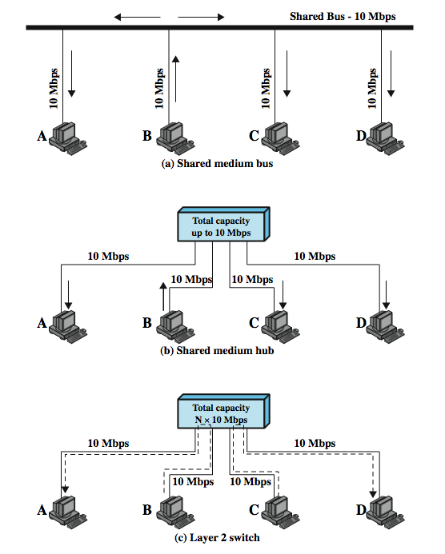
Shared Medium Bus and Hub
Notes:
In recent years, a new device, the layer 2 switch, has replaced the hub in popularity, particularly for high-speed LANs. The layer 2 switch is also sometimes referred to as a switching hub.
To clarify the distinction between hubs and switches, Stallings DCC9e Figure 15.12a shows a typical bus layout of a traditional 10-Mbps LAN. A bus is installed that is laid out so that all the devices to be attached are in reasonable proximity to a point on the bus. In the figure, station B is transmitting. This transmission goes from B, across the lead from B to the bus, along the bus in both directions, and along the access lines of each of the other attached stations. In this configuration, all the stations must share the total capacity of the bus, which is 10 Mbps.
Stallings DCC9e Figure 15.12b illustrates the operation of a hub. Here again, station B is transmitting. This transmission goes from B, across the transmit line from B to the hub, and from the hub along the receive lines of each of the other attached stations.
Stallings DCC9e. Figure 15.12c shows an example in which B is transmitting a frame to A and at the same time C is transmitting a frame to D. So, in this example, the current throughput on the LAN is 20 Mbps, although each individual device is limited to 10 Mbps.

Slide 44
Layer 2 Switch Benefits
no change to attached devices to convert bus LAN or hub LAN to switched LAN
e.g. Ethernet LANs use Ethernet MAC protocol
have dedicated capacity equal to original LAN
assuming switch has sufficient capacity to keep up with all devices
scales easily
additional devices attached to switch by increasing capacity of layer 2
Notes:
The layer 2 switch has several attractive features:
1. No change is required to the software or hardware of the attached devices to convert a bus LAN or a hub LAN to a switched LAN. In the case of an Ethernet LAN, each attached device continues to use the Ethernet medium access control protocol to access the LAN. From the point of view of the attached devices, nothing has changed in the access logic.
2. Each attached device has a dedicated capacity equal to that of the entire original LAN, assuming that the layer 2 switch has sufficient capacity to keep up with all attached devices. For example, in Figure 15.12c, if the layer 2 switch can sustain a throughput of 20 Mbps, each attached device appears to have a dedicated capacity for either input or output of 10 Mbps.
3. The layer 2 switch scales easily. Additional devices can be attached to the layer 2 switch by increasing the capacity of the layer 2 switch correspondingly.

Slide 45
Types of Layer 2 Switches
store-and-forward switch
accepts frame on input line, buffers briefly, routes to destination port
see delay between sender and receiver
boosts overall integrity
cut-through switch
use destination address at beginning of frame
switch begins repeating frame onto output line as soon as destination address is recognized
highest possible throughput
risk of propagating bad frames
Notes:
Two types of layer 2 switches are available as commercial products:
Store-and-forward switch: The layer 2 switch accepts a frame on an input line, buffers it briefly, and then routes it to the appropriate output line.
Cut-through switch: The layer 2 switch takes advantage of the fact that the destination address appears at the beginning of the MAC (medium access control) frame. The layer 2 switch begins repeating the incoming frame onto the appropriate output line as soon as the layer 2 switch recognizes the destination address.
The cut-through switch yields the highest possible throughput but at some risk of propagating bad frames, because the switch is not able to check the CRC prior to retransmission. The store-and-forward switch involves a delay between sender and receiver but boosts the overall integrity of the network.

Slide 46
Layer 2 Switch vs. Bridge
differences between switches & bridges:
layer 2 switch can be viewed as full-duplex hub
incorporates logic to function as multiport bridge
new installations typically include layer 2 switches with bridge functionality rather than bridges
Bridge
frame handling done in software
analyzes and forwards one frame at a time
uses store-and-forward operation
Switch
performs frame forwarding in hardware
can handle multiple frames at a time
can have cut-through operation
Notes:
A layer 2 switch can be viewed as a full-duplex version of the hub. It can also incorporate logic that allows it to function as a multiport bridge. The following are differences between layer 2 switches and bridges:
Bridge frame handling is done in software. A layer 2 switch performs the address recognition and frame forwarding functions in hardware.
A bridge can typically only analyze and forward one frame at a time, whereas a layer 2 switch has multiple parallel data paths and can handle multiple frames at a time.
A bridge uses store-and-forward operation. With a layer 2 switch, it is possible to have cut-through instead of store-and-forward operation.
Because a layer 2 switch has higher performance and can incorporate the functions of a bridge, the bridge has suffered commercially. New installations typically include layer 2 switches with bridge functionality rather than bridges.

Slide 47
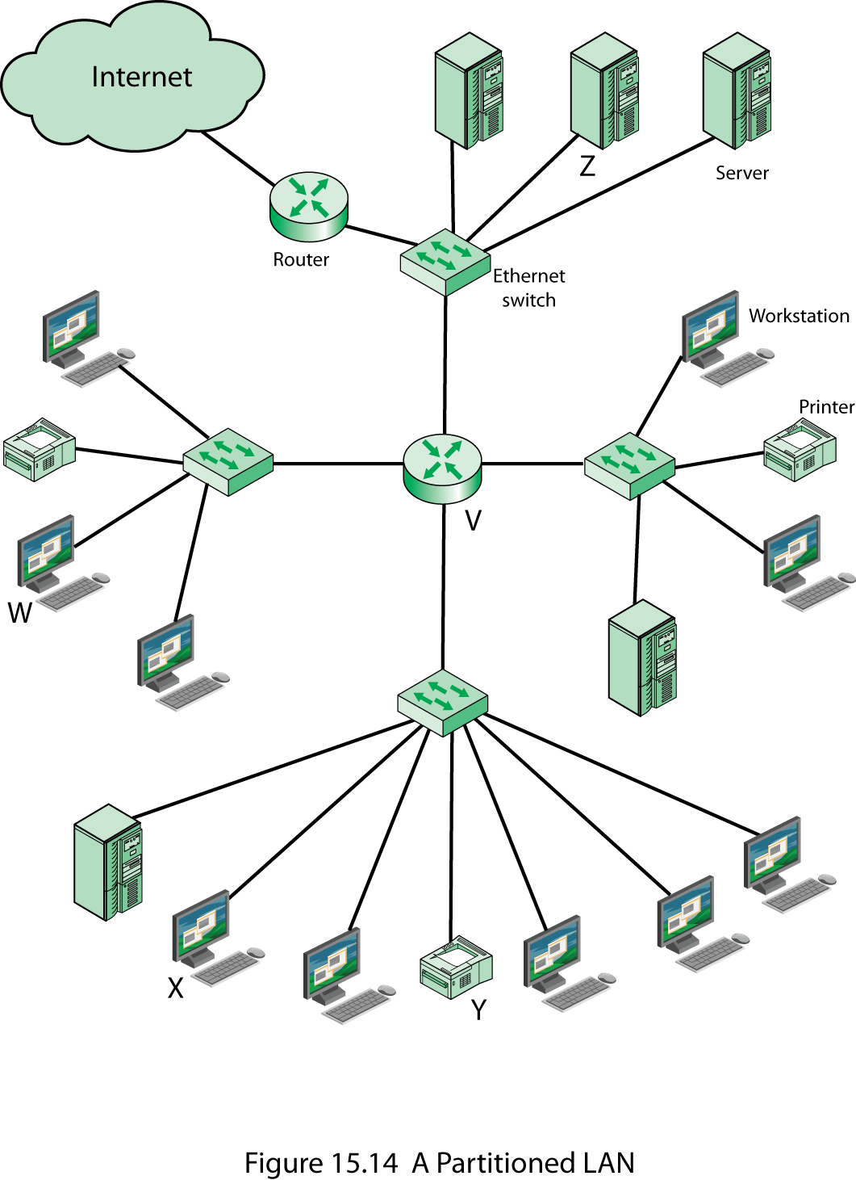
A Partitioned LAN Configuration
Notes:
Stallings DCC9e Figure 15.13 shows a relatively common type of hierarchical LAN configuration. In this example, the devices on the LAN are organized into four groups, each served by a LAN switch. The three lower groups might correspond to different departments, which are physically separated, and the upper group could correspond to a centralized server farm that is used by all the departments.
Let us consider the transmission of a single MAC frame from workstation X. Suppose the destination MAC address in the frame (see Stallings DCC9e Figure 15.6) is workstation Y. This frame is transmitted from X to the local switch, which then directs the frame along the link to Y. If X transmits a frame addressed to Z or W, then its local switch routes the MAC frame through the appropriate switches to the intended destination. All these are examples of unicast addressing, in which the destination address in the MAC frame designates a unique destination. A MAC frame may also contain a broadcast address, in which case the destination MAC address indicates that all devices on the LAN should receive a copy of the frame. Thus, if X transmits a frame with a broadcast destination address, all of the devices on all of the switches in Figure 15.13 receive a copy of the frame. The total collection of devices that receive broadcast frames from each other is referred to as a broadcast domain.
In many situations, a broadcast frame is used for a purpose, such as network management or the transmission of some type of alert, that has a relatively local significance. Thus, in Figure 15.13, if a broadcast frame has information that is only useful to a particular department, then transmission capacity is wasted on the other portions of the LAN and on the other switches.
One simple approach to improving efficiency is to physically partition the LAN into separate broadcast domains, as shown in Stallings DCC9e Figure 15.14. We now have four separate LANs connected by a router. In this case, an IP packet from X intended for Z is handled as follows. The IP layer at X determines that the next hop to the destination is via router V. This information is handed down to X's MAC layer which prepares a MAC frame with a destination MAC address of router V. When V receives the frame, is strips off the MAC header, determines the destination, and encapsulates the IP packet in a MAC frame with a destination MAC address of Z. This frame is then sent to the appropriate Ethernet switch for delivery.
The drawback to this approach is that the traffic pattern may not correspond to the physical distribution of devices. For example, some departmental workstations may generate a lot of traffic with one of the central servers. Further, as the networks expand, more routers are needed to separate users into broadcast domains and provide connectivity among broadcast domains. Routers introduce more latency than switches because the router must process more of the packet to determine destinations and route the data to the appropriate end node.

Slide 48
Virtual LANs (VLANs)
subgroup within a LAN
created by software
combines user stations and network devices into a single broadcast domain
functions at the MAC layer
router required to link VLANs
physically dispersed but maintains group identity
Notes:
The Use of Virtual LANs
A more effective alternative is the creation of virtual LANs (VLANs). In essence, a VLAN is a logical subgroup within a LAN that is created by software rather than physically moving and separating devices. It combines user stations and network devices into a single broadcast domain regardless of the physical LAN segment they are attached to and allows traffic to flow more efficiently within populations of mutual interest. The VLAN logic is implemented in LAN switches and function at the MAC layer. Because their purpose is to isolate traffic within the VLAN, in order to link from one VLAN to another, a router is required. Routers can be implemented as separate devices, so that traffic from one VLAN to another is directed to a router, or the router logic can be implemented as part of the LAN switch, as shown in Stallings DCC9e Figure 15.15.
VLANs provide the ability for any organization to be physically dispersed throughout the company while maintaining its group identity. For example, accounting personnel can be located on the shop floor, in the research and development center, in the cash disbursement office, and in the corporate offices, while at the same time all members reside on the same virtual network, sharing traffic only with each other.

Slide 49
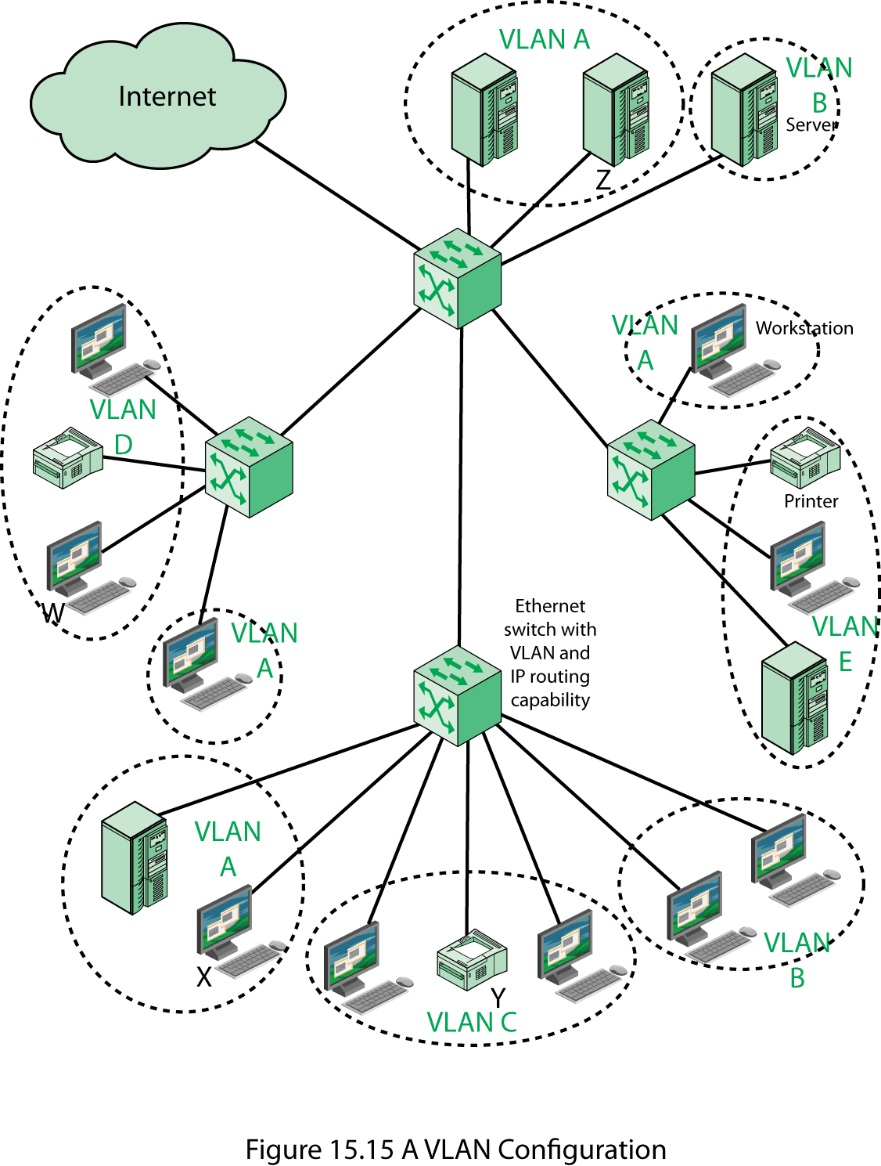
A VLAN Configuration
Notes:
In Stallings DCC9e Figure 15.15, five VLANs are defined. A transmission from workstation X to server Z is within the same VLAN, so it is efficiently switched at the MAC level. A broadcast MAC frame from X is transmitted to all devices in all portions of the same VLAN. But a transmission from X to printer Y goes from one VLAN to another. Accordingly, router logic at the IP level is required to move the IP packet from X to Y. In Figure 15.15, that logic is integrated into the switch, so that the switch determines whether or not the incoming MAC frame is destined for another device on the same VLAN. If not, the switch routes the enclosed IP packet at the IP level.

Slide 50
Defining VLANs
broadcast domain consisting of a group of end stations not limited by physical location and communicate as if they were on a common LAN
membership by:
port group
MAC address
protocol information
Notes:
Defining VLANs
A VLAN is a broadcast domain consisting of a group of end stations, perhaps on multiple physical LAN segments, that are not constrained by their physical location and can communicate as if they were on a common LAN. Some means is therefore needed for defining VLAN membership. A number of different approaches have been used for defining membership, including the following:
Membership by port group: Each switch in the LAN configuration contains two types of ports: a trunk port, which connects two switches, and an end port, which connects the switch to an end system. A VLAN can be defined by assigning each end port to a specific VLAN. This approach has the advantage that it is relatively easy to configure. The principle disadvantage is that the network manager must reconfigure VLAN membership when an end system moves from one port to another.
Membership by MAC address: Since MAC-layer addresses are hard-wired into the workstation’s network interface card (NIC), VLANs based on MAC addresses enable network managers to move a workstation to a different physical location on the network and have that workstation automatically retain its VLAN membership. The main problem with this method is that VLAN membership must be assigned initially. In networks with thousands of users, this is no easy task. Also, in environments where notebook PCs are used, the MAC address is associated with the docking station and not with the notebook PC. Consequently, when a notebook PC is moved to a different docking station, its VLAN membership must be reconfigured.
Membership based on protocol information: VLAN membership can be assigned based on IP address, transport protocol information, or even higher-layer protocol information. This is a quite flexible approach, but it does require switches to examine portions of the MAC frame above the MAC layer, which may have a performance impact.

Slide 51
Communicating VLAN Membership
Switches need to know VLAN membership
configure information manually
network management signaling protocol
frame tagging (IEEE802.1Q)
Notes:
Switches must have a way of understanding VLAN membership (that is, which stations belong to which VLAN) when network traffic arrives from other switches; otherwise, VLANs would be limited to a single switch. One possibility is to configure the information manually or with some type of network management signaling protocol, so that switches can associate incoming frames with the appropriate VLAN.
A more common approach is frame tagging, in which a header is typically inserted into each frame on interswitch trunks to uniquely identify to which VLAN a particular MAC-layer frame belongs. The IEEE 802 committee has developed a standard for frame tagging, IEEE 802.1Q, which we examine in the next chapter.

Slide 52
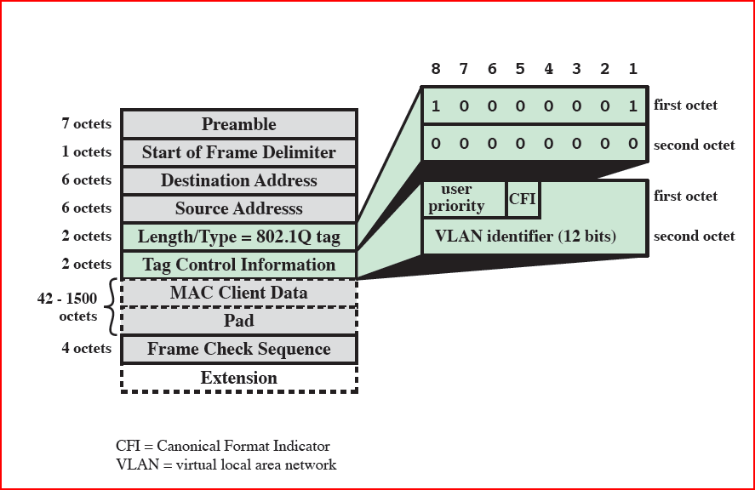
Frame Tagging – IEEE 802.1q

Slide 53

Summary
LAN topologies and transmission media
bus, tree, ring, star
LAN protocol architecture
IEEE 802, LLC, MAC
bridges, hubs, layer 2 switches
virtual LANs
Notes:
Stallings DCC9e Chapter15 summary.

